Slide 1
Linear Regression Subjective Answers

Slide 2
From your analysis of the categorical variables from the dataset, what could you infer about their effect on the dependent variable?

Slide 3
Why is it important to use drop_first=True during dummy variable creation?
Drop_First helps in reducing the number of dummy variables by reducing the number of columns generated.
For e.g. if there are 3 levels in a certain categorical variable (A,B,C) it can be easily represented by 2 dummy variables.
B | C | Result
0 | 0 | A
1 | 0 | B
0 | 1 | C

Slide 4
Looking at the pair-plot among the numerical variables, which one has the highest correlation with the target variable?
The Target variable is cnt (total count) of users.
The features that have the highest correlation are :
Temperature (temp)
Feeling Temperature(atemp)
Both have a correlation value of 0.63
The values casual and registered also are highly correlated but that is only because cnt = casual + registered.

Slide 5
How did you validate the assumptions of Linear Regression after building the model on the training set?

Slide 6
Based on the final model, which are the top 3 features contributing significantly towards explaining the demand of the shared bikes?

Slide 7
Explain the linear regression algorithm in detail

Slide 8
Explain the Anscombe’s quartet in detail.

Slide 9
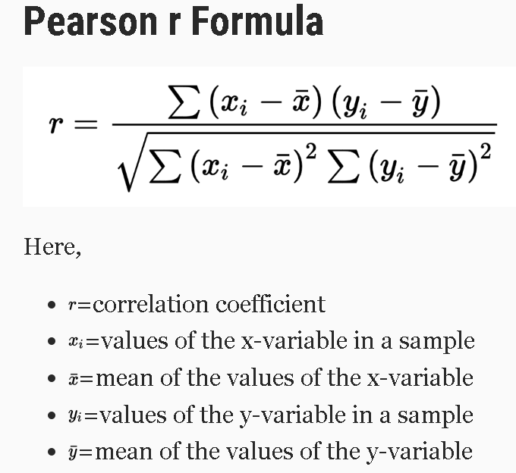
What is Pearson’s R?
Named after Karl Pearson, the Pearson’s Correlation Coefficient is a statistic that measures the linear relationship between two variables.
It has a numerical range -1 to +1.
Interpretation:
The closer the absolute value is to 1, the more highly correlated are the two variables.
The sign signifies the slope:
+1 : perefectly linear with +ve slope (both variables change in the same direction:
-1 : perfectly linear with –ve slope (both variables change in opposite directions)
0: no correlation

Slide 10
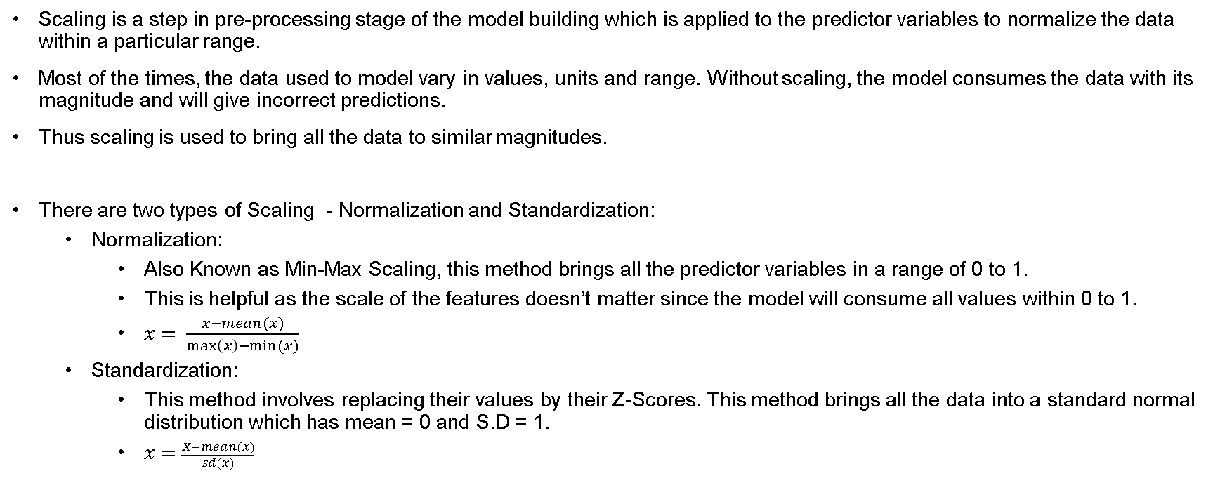
What is scaling? Why is scaling performed? What is the difference between normalized scaling and standardized scaling?
Scaling is a step in pre-processing stage of the model building which is applied to the predictor variables to normalize the data within a particular range.
Most of the times, the data used to model vary in values, units and range. Without scaling, the model consumes the data with its magnitude and will give incorrect predictions.
Thus scaling is used to bring all the data to similar magnitudes.
There are two types of Scaling - Normalization and Standardization:
Normalization:
Also Known as Min-Max Scaling, this method brings all the predictor variables in a range of 0 to 1.
This is helpful as the scale of the features doesn’t matter since the model will consume all values within 0 to 1.
$x= \frac{x−mean(x)}{\max\left(x\right)−min⁡(x)}$
Standardization:
This method involves replacing their values by their Z-Scores. This method brings all the data into a standard normal distribution which has mean = 0 and S.D = 1.
$x=\frac{X−mean(x)}{sd(x)}$

Slide 11

You might have observed that sometimes the value of VIF is infinite. Why does this happen?
Variable Inflation factor (VIF) provides a measure of how one independent variable is explained by all the other independent variables combined.
$VIF=\frac{1}{1−R^{2}}$
VIF can only be infinity when $R^{2}$ is 1 i.e all the independent variables are perfectly correlated to each other.

Slide 12
What is a Q-Q plot? Explain the use and importance of a Q-Q plot in linear regression.
Quantile-Quantile (Q-Q) plot, is a graph that helps to assess if a set of data came from same distribution. It also helps to determine if two data sets come from same population.
This helps in linear regression when we have training and test data set received separately and then we can confirm using Q-Q plot that both the data sets are from populations with same distributions.
If the two distributions being compared are similar, the points in the Q–Q plot will approximately lie on the line y = x.
If the distributions are linearly related, the points in the Q–Q plot will approximately lie on a line, but not necessarily on the line y = x.

